Slide 1
General Data Protection Regulation (GDPR) An introduction
May 2018

Slide 2
What the Information Commissioner says
GDPR updates existing requirements – it’s evolution not revolution!
It’s a journey requiring ongoing effort – not a race ending on 25th May 2018
‘those who self-report, who engage with ICO to resolve issues and who can demonstrate effective accountability arrangements can expect this to be taken into account when we consider any regulatory action’

Slide 3
Why you need to know?
Pet Blood Bank will be ‘processing’ personal information for employees and other workers, service users, volunteers, trustees, partner agencies
ensure personal info is proportionate, managed appropriately and secure
Handling requests for personal information
Eg requests from employees, service users, partner agencies
The use of suppliers and third parties to provide services
Ensure your contracts protect the personal information you are responsible for
Data Controller (ie the employer) and Data Processor (3rd party) are jointly liable

Slide 4
Data Protection Principles
Fairly and lawfully processed
Processed for limited purposes
Adequate, relevant and not excessive
Accurate and up to date
Must not be kept for longer than is necessary
Processed in line with the data subjects’ rights
Notes:
DP principles haven’t changed

Slide 5
Accountability
Accountability is a key GDPR concept
Employers need to demonstrate that their GDPR obligations have been complied with
Formal “impact assessments” required where there is a high risk to data subjects
Need to give appropriate instructions (training) to employees handling personal data
Ensuring accountability will require regular review

Slide 6
Minimalist Data Retention
Minimisation links in with principles of privacy by design and default
Is not simply concerned with retention periods – must regularly review what data collected and why necessary
DPA
Personal data shall be adequate relevant and not excessive
GDPR
Personal data shall be adequate, relevant and limited to what is necessary

Slide 7
Language
Data Subject
An individual who is the subject of personal data
Data Controller
A person who determines the purposes for which and the way any personal data is processed eg an employer
Data Processor
Any person who processes personal data on behalf of the Data Controller eg outsourced third party provider – eg payroll provider, recruitment consultant, benefit provider
Processing
obtaining, collecting, recording, organising, storing, amending, retrieving, disclosing and/or destroying information or using it or doing anything with it

Slide 8
Language
Personal Information
Information, known as personal data, means information relating to a living individual who can be identified (directly or indirectly) from that information.
Any information relating to an identified or identifiable natural person directly or indirectly by reference to an identifier such as a name, an identification number, location data, an online identifier or to one or more factors specific to the physical, physiological, genetic, mental, economic, cultural or social identity of that natural person.
Eg names, email addresses, opinions, identification numbers, cookies, IP addresses, biometrics, health related data element, photographs,
Context is the key – the more data that is ‘bundled’ (combined) the greater the risk
Recommend erring on the side of caution
Notes:
CONTEXT – spreadsheet with first name only isn’t on first glance an issue, but if put together with address or DOB then individual becomes identifiable

Slide 9
Not all data is the same
Notes:
Sensitive Personal Data now known as SPECIAL CATEGORIES - broadly similar to sensitive personal data

Slide 10
Special Categories
Still need lawful basis, but in addition need to identify additional conditions for processing special category data, for example
Explicit consent
Necessary for preventative or occupational medicine (Occ health reports)
Necessary where individual unable to give consent

Slide 11
Criminal Offence Data
Data relating to convictions and offences or related security measures
Covers data about allegations, proceedings or convictions that would have been ‘sensitive data’ under the outgoing Act
Prohibition on collection and processing of criminal data
unless legally required, or
local (ie UK) derogation
Requires a lawful basis for consent (same as any other data), but
Also need to comply with Article 10
Processing has to be in an official capacity or needs specific legal authorisation (is likely to be defined in the new DP Act)
Notes:
Moving on to the issue of DBS checks, and this is another example of the GDPR in practice within HR.
The GDPR imposes a prohibition on the collection and processing of criminal data, unless legally required. This means that routine, basic DBS checks will be more problematic. However, Member States are allowed to exercise a derogation in respect of this form of processing special personal data, and the UK Government is proposing to substantially preserve current DBS operations through the new Data Protection Act. However, the Act proposes that if DBS checks are to be undertaken, employers will need a detailed policy identifying how they will protect the information and dispose of it.
It is not yet known whether such a policy will need to be separate from the required general data protection policy under the GDPR, but what is clear is that many employers will need to reconsider current practice, how this is communicated, and importantly how this is justified.
You may need to assess whether you need to carry out criminal record checks; review your current recruitment processes; and ensure that the data minimisation principles ie how long your hold information for are considered

Slide 12
Criminal Offence Data
Certain checks will still be permitted
conducting routine basic checks will be more problematic
What should you do?
assess necessity of obtaining criminal records data
review recruitment processes and application forms
ensure data minimisation principles are met eg how long you hold the information for
ICO still to publish more detailed guidance once legislation finalised

Slide 13
Lawful Basis for Processing
Consent
Currently employers rely on ‘consent’ to process personal data
Often within the employment contract/written statement
GDPR – where an imbalance of power, consent invalid
ICO – consent unlikely to be acceptable basis for processing employment data under GDPR

Slide 14
Lawful Basis for Processing
Consent
Contract with individual
Legitimate interests
Compliance with legal obligation
Vital interests of individual
Public interest
Notes:
So if employee consent to processing is no longer a viable option, how should HR respond? Processing will need to be justified on the other legally-recognised grounds shown on the slide. Employers need to consider whether processing is NECESSARY (not just “nice to have”):
for the performance of the employment contract or for preparatory steps related to it;
for employer compliance with a legal obligation;
to protect the employee’s vital interests (or those of another);
for a task carried out in the public interest;
for the purposes of the legitimate interests of the employer (or third party).
These grounds do not apply to sensitive personal data now called special categories (such as information about race, health, or sexual orientation) which require additional conditions for processing to be complied with.
The idea of not relying upon consent may be much worse than the reality – a large percentage of processing for which HR is responsible will by its nature fall into one of these categories (e.g. simple payroll information and contact details are clearly “necessary” to the employment contract.). The key change for HR personnel is therefore to identify these reasons for processing and to record them. It should be noted that when an employer is relying upon the legitimate interests condition for processing the GDPR requires that employees are informed of what these legitimate interests are – it is no longer sufficient simply to say that personal data will be processed in the pursuit of one of the organisation’s legitimate interests without clarifying what that means.

Slide 15
Consent and ‘special categories’
As well as a lawful basis for processing, ‘special categories’ require a separate condition for processing
Explicit consent
Protect vital interests of data subject
Preventative or occupational medicine

Slide 16
Rights & Obligations
Access
Accuracy/Rectification
To be Forgotten (Erasure)
Restrict Processing
Object
Data Portability

Slide 17
NEW Right to Erasure (be forgotten)
Organisation must:
Individual has right to erasure if:
Personal data is no longer necessary
Consent withdrawn
Their data has been unlawfully processed
Legal obligation to erase
Data was added to social media while under 18
Comply with request unless it has a legal obligation to continue processing the data
If personal data has been made public take steps to inform any other processors of data subjects request for erasure

Slide 18
New Right to Restriction of Processing
Individuals can request:
Organisations must:
Restriction of processing until accuracy claim is verified
Retention of unlawfully processed data
Retention of data for exercise or defence of legal claims
Take steps to ensure restriction as requested
Only recommence processing on data subject request
Inform data subject if data processing will recommence and why

Slide 19
New Right to Data Portability
Individuals have the right to receive their personal data in a structured, commonly used and machine-readable format and the right to transmit those data to another controller without hindrance
Only applies if data is processed by consent or contract AND
Processing is carried out by automated means

Slide 20
Privacy Notices
Who you are; what you are going to do with info and who it will be shared with
It can allow for development in the way you use personal data
Consider how to gain/record individual’s consent if required
Fundamental difference between telling someone how you’ll use their data and gaining their consent
When relying on consent, be clear and unambiguous and ask for positive opt-in
Must be more than ‘I agree’ box
If appropriate, explain different ways info will be used
must be able to ‘agree’ to each type of processing – not all or nothing
To help decide on what to include, map out the flow of information and how you process it*
Notes:
what information you hold that constitutes personal data;
what you do with the personal data you process;
what you actually need to carry out these processes - a privacy impact assessment can help you to answer this question;
whether you are collecting the information you need;
whether you are creating derived or inferred data about people, for example by profiling them; and
whether you will be likely to do other things with it in the future – this can be particularly important if you are undertaking large scale analysis of data, as in big data analytics.

Slide 21
Employee Privacy Notice
Who you are: Employer’s identity and contact details
How does the organisation protect your data
Purposes for which data will be processed and legal basis for doing so
What info the organisation collects; categories of personal data to be processed
Who has access to data and who it will be shared with
Any transfers beyond EEA
Period of storage of data (or criteria used to determine)
Rights of data subjects (including to complain)
Existence of automated decision-making
Notes:
As well as DP Officers contact details – if you have one
GDPR requires employers to be proactive in communicating to employees how their personal data will be processed. Employees must be advised what data will be collected, retained or processed, by whom and for how long. They must also be informed of their rights of access to their data, ability to object to or correct it and to whom they can complain if the employer fails to comply. Communications to employees are often called privacy notices and they will be key to meeting this obligation.
[Question: Who knows where their organisation’s current privacy notices can be found?]
The GDPR says that the privacy notice needs to have significant detail, but also needs to be clear and accessible. The use and content of privacy notices is an area in which HR professionals are likely to play an essential role, so you will need to give thought as to the information which is communicated to staff. For the most part the information must be provided at the time of data collection.
You will also need to consider how privacy notices may be adapted for the individual concerned, for example as between existing and potential staff. For current employees a new or updated privacy notice may be implemented; for new employees the information could be included with other induction material or training; and for job applicants privacy notice details may be provided before applications are lodged and data provided.
As with accountability, privacy notices will require regular review and updating. They must reflect data protection practice in reality at any given time.
The Information Commissioner’s Office has produced a Code of Practice concerning privacy notices which you may find helpful.

Slide 22
What does it look like?
Information we collect | How we collect it | Why we collect it | How we use it and may share it
Name, contact details (address, phone nos, email address) and emergency contact details | From you | To enter into/perform the contract Legitimate Interest: to maintain employment records and good employment practice | To enter into and perform the contract
Nationality and immigration status and info from related documents eg passport or other ID and immigration info | From you and, where necessary, the Home Office | To enter into/perform the contract To comply with our legal obligations Legitimate interest: to maintain employment records | To carry out right to work checks Information may be shared with Home Office
Details of salary/benefits/bank/ Building soc, NI and tax info, your age | From you From HMRC | To perform the employment contract including payment of salary and benefits Legitimate interest: maintain employment records and comply with legal and regulatory obligations and good employmen practice

Slide 23
Data Processors
Third party engagement
identify third parties who process data for you
existing third party agreement terms unlikely to be GDPR compliant; who will re-negotiate?

Slide 24
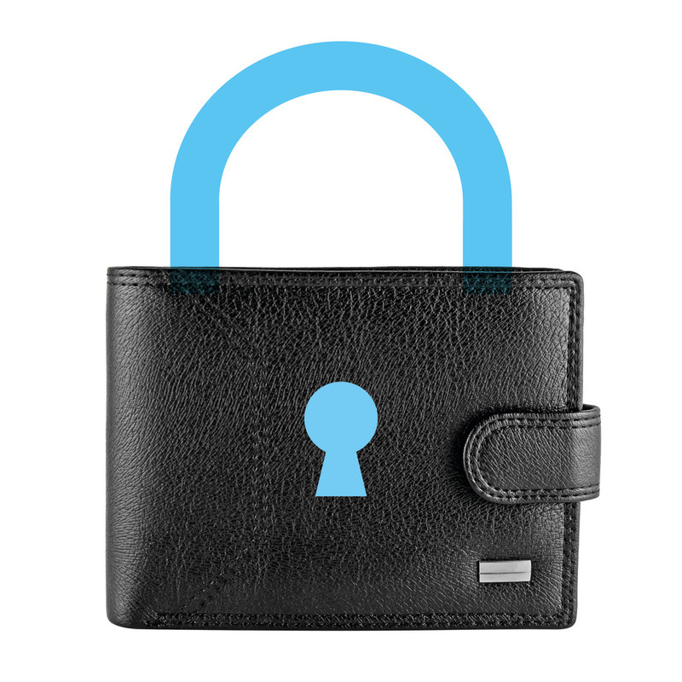
Data Breach Reporting
Report breaches without undue delay and within 72 hours
If high risk to individuals notify of breach without undue delay
Must document breach in all cases
High penalties if obligation not observed

Slide 25
Increased Penalties
Currently up to £500k
GDPR – two tier systems of fines
Lesser incidents €10m or 2% t/o whichever is greater
Serious violations €20m or 4% t/o whichever is greater
Last years’ fines (£880,500) - under GDPR £69m
For example:
Talk Talk fined £400k – under GDPR fined £59m
Pharmacy2U £130k – under GDPR £4.4m
Breaches can also be published – reputational damage to consider
Notes:
Fines are X79 under GDPR

Slide 26
key changes….
New and enhanced individual rights
Stricter rules on basis for processing
Increased accountabilitiy
Significantly higher penalties

Slide 27
In summary …….
Establish who will drive GDPR compliance
Map flow of information– keep written record
Update and issue:
Privacy Notices
Consents
Policies (DP, IT use, Social Media, Retention)
Replace ‘consent’ clause in employment contracts
Identify 3rd parties who process data for you
Who will update/re-negotiate?
Provide training
Notes:
Likely won’t require DPO

Slide 28
…… and finally
NEVER
ALWAYS
Share confidential info
Connect unauthorised devices
Disclose your password(s)
Make assumptions about identities
be aware before you share!
Keep computers/devices locked
Lock away confidential papers
Know what’s in your policies/procedures
Report any breaches or near breaches
Seek management advice is unsure on concerned

